Slide 1


Slide 2

Social Media in numbers
Youtube
Number of posts: 62 (7%)
Number of Subs: 47 (10%)
Number of views: 822 (24%)
Instagram
Number of posts: 6 (50%)
Number of Followers: 60 (-1%)
Number of views: 295 (66%)
TikTok
Number of posts: 6 (50%)
Number of Followers: 2 (-)
Number of views: 95 (50%)

Slide 3
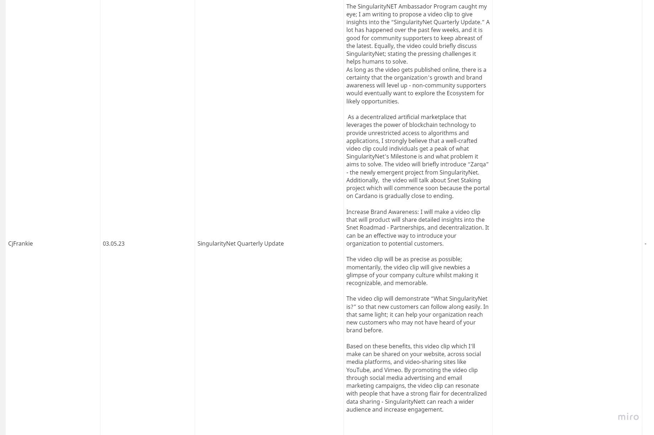
Earlier Accepted Proposals
None

Slide 4
New Proposals
CjFrankie: Done quarterly video
LilyCupcake: Semi-done quarterly video
LilyCupcake: 5 clips done

Slide 5
New Workgroup Members
New members: 0
Current members count: 11

Slide 6

Tasks to cover

Slide 7
Keep up the good work!

